Slide 1
Trauma-Informed APPROACH TO HOUSING SERVICES
2024

Slide 2
Agenda:
Trauma-Informed Approach
Power Differentials
Language Matters!
Finding a Home & Leasing Up
Year 1 (Honeymoon Year)
My Client is Getting Evicted!?

Slide 3
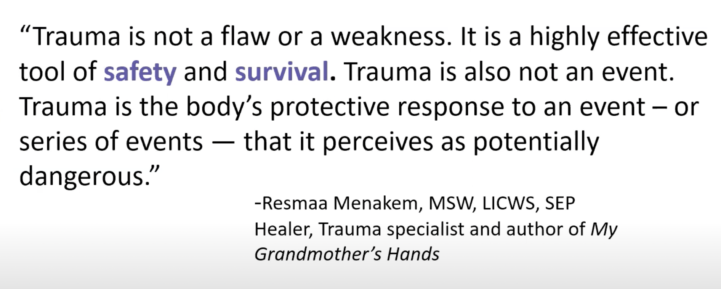
What is trauma?
Trauma results from an event, or series of events, or set of circumstances that is experienced by an individual as physically or emotionally threatening, and that has lasting adverse effects on the individual’s functioning and physical, social, emotional, or spiritual well-being. ~SAMSHA
  Trauma is an effective survival mechanism that keeps us safe (“Never again will I be hurt this way…”).
    Honor that your participant survived!
    Recognize how trauma creates barriers to services.
    Trauma doesn’t mix well with language. Notice when a participant’s behaviors might indicate trauma response.
  Research shows that as little as one traumatic incident can change a person’s genes in a way that it’s passed down through at least three generations through epigenetic inheritance (Dr. Oded Rechavi, Tel Aviv University).
Notes:
Different than evolution…it’s a very rapid means of

Slide 4

What is Trauma-informed care?
Trauma-informed care (TIC) is a strengths-based approach that is grounded in the understanding of (and responsiveness to) the impact of trauma within the context of service delivery.
Emphasizes physical, psychological, and emotional safety for both providers and survivors.
Creates opportunities for survivors to rebuild a sense of control, autonomy, and empowerment.
Anticipates and attempts to avoid institutional and individual practices that are likely to retraumatize individuals who already have histories of trauma. (Systemic trauma = that’s us!)
Upholds the importance of participation in the creation, delivery, and evaluation of services.​
​
Source: SAMHSA

Slide 5
implement a trauma-informed approach
Safety first! Participants need to feel physically and psychologically safe.
  What does your environment look like? (Lighting, space, exits, art, signs/gestures of welcome.)
  Patience pays off.
  Understand that the housing process itself = traumatic.
Transparency builds trust!
  Interactions with participants are authentic, collaborative, and clear.
Empowerment & choice!
  Allow participants to lead the decisions in their housing journey. They have the right to deny a unit that is found.
Collaboration and mutuality!
  Do not keep secrets. Have hard conversations. Share the good & bad with your participant. This builds healing & trust, and it helps balance the power differential.
Cultural, historic, and gender considerations!
  Honor the experiences of historically disadvantaged people. Does your program actively work to remediate its own biases at the policy, programmatic, and individual level? Have you discussed cultural, historic, and gender considerations with your participant?

Slide 6
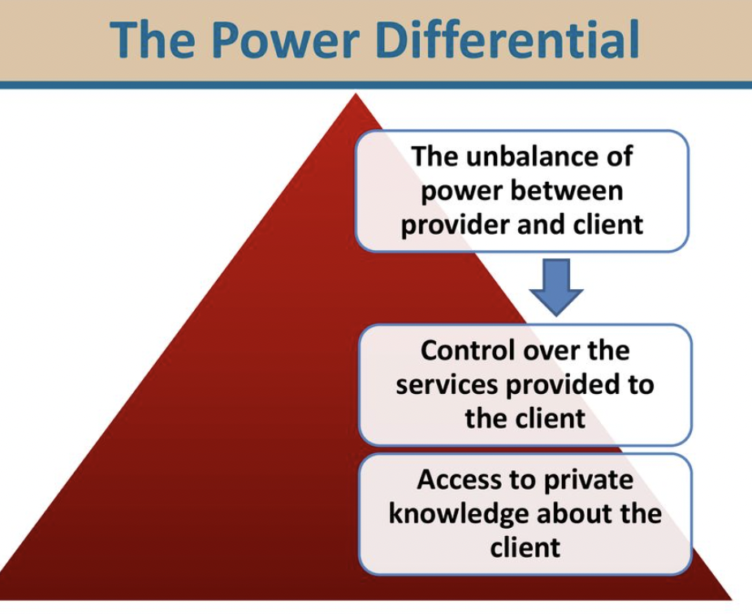
Power differentials
Role difference between two people that results in vulnerability on the part of the less empowered.
  Position/Title
  Knowledge
  Perceived Wealth
  Resources
  Perceived Status
  Language
  Gender
  Race/Ethnicity
Inherently built into case management
Erodes trust if not addressed
Build on soft skills (trust)
MI & curiosity approach
Establish ground rules

Slide 7

Language matters
Written policy best practice recommendation =
6th grade reading level (we are often working with a population who is not at this level)
Are documents translated into participants’ first language for informed consent on legal documents?
Spokane International Translation
In a pinch, try Google Translate

Slide 8

What we say matters
Instead of… | …Practice
“Look on the bright side” | “I hear how this experience impacted you” or “That was a really crummy outcome”
“You no-showed last week” | “Was there something that kept you from getting here last time? How can I help?”
“That’s crazy” or “That sounds insane” | “That’s wild” or “That’s bananas!”
“That’s not going to happen” | “Let’s look at the facts”
“What did you expect?” or “I told you so” | “That was unfortunate. How can I help?”
“I know exactly what you’re going through” (Self-disclosure = in service to the participant, not yourself) | “That sounds terrible!” or “What was that experience like for you?” (Listen, explore, be curious)

Slide 9


Finding a home….
My definition of safety may not be your definition of safety. (Autonomy & empowerment!)
Can you do a walk-through with your participant prior to move-in?
Accessibility (laundry, groceries, med appts)
Pest free?
Location & preferences
Is the landlord accessible?
Is the maintenance procedure clear?
Once moved in…do doors, windows and locks function?
Child safe?
Are carpet & walls clean?
Do the bathroom and kitchen sink drain?
Is there mold?
Is there a safe exit?
Is the route to transportation accessible in all seasons?

Slide 10

What to do if my participant has an eviction or owes back rent/utilities?
Spokane County Court Viewer
Annualcreditreport.com (every 12 months = free; 3 entities to request from)
Contact prior landlords & Avista if there’s a question of debt owed (obtain ROI)
Set up a payment plan prior to application
”I Am Awesome” Letter
  What happened, why, and what have they done to change the behavior?
  Character reference letters (especially from past landlords)
If an eviction sounds fishy…contact SHA, Fair Housing, or NW Justice Project

Slide 11

What to look for in a trauma-informed landlord
Advocate for your resident!
Is Section 8 accepted as a form of income?
  SHA, NW Justice Project, NW Fair Housing Alliance.
Does the landlord honor the option of paying certain up-front fees in an installment instead of all at once?
  Deposits, nonrefundable fees, & last month’s rent in 3 consecutive & equal installments. (Deposit waiver fee = nonrefundable.)
Does the landlord understand VAWA?
  If DV is not reported, the landlord can treat police calls as criminal activity and evict. Educate your participant!
Goodbye rent bidding!
  2024: Landlords cannot pressure renters to pay more than advertised rent.
Eviction Process
  2024 = Remote option for court attendance.
  Evictions must go through court in WA State.
  Mandatory mediation option ended in June 2023.
SCRABBLE SCORE = 10 POINTS!

Slide 12

advocacy during APPLICATION AND lease-up
Educate participants on being document ready and updating wait lists with current contact info
CMIS = upload documents & bring printed copies to lease-up (IDs, homeless verification, disability verification, income verification)
you can help track wait lists and contact info; you can list yourself as 2nd contact on all apps (“or [title] designee”)
PBV units can be inspected prior to tenant being identified (speeds up the process)
Go to appointments with your person

Slide 13




1st year stabilization
Why is year 1 key to stabilization? (Address barriers, build community, establish follow-up care).
Go over the lease with your participant; highlight & write notes. Make a simplified cheat sheet.
What is most likely to make someone lose housing in that first year?
  Nonpayment, unauthorized occupants, disruptive behaviors, altering or damaging unit, not allowing routine entry for inspections, pest control.
Recertification is a key moment (help participant track; SHA no longer notifies case managers of upcoming dates).

Slide 14

What to do if a PERSON I housed receives an eviction notice?

Slide 15

Questions?

Slide 16
Thank you!
Megan Curran (Transitions):
mcurran@help4women.org
Laurie Dove (Kiemle Hagood):
laurie.dove@kiemlehagood.org

